Slide 1
Bone Fractures Localization
Presented by Group 5: David Boulos, Jeffrey Conner, Aria Kieras & Nhu Tran

Slide 2
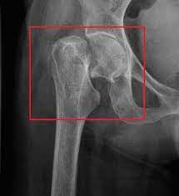
Project Overview
Fractures Localization
FracAtlas Dataset
Models:
ResNet18 (baseline)
DenseNet121 (baseline)
Faster R-CNN (initial solution)
YOLOv8(refined solution)

Slide 3
Dataset Summary
FracAtlas:
Data folder Images, Annotations, Utilities folders and a metadata file.
Images are divided into Fractures vs Non-fractures
Image Format: JPG
Annotations: COCO, VGG, YOLO and PASCAL VOC.
Source: https://figshare.com/articles/dataset/The_dataset/22363012?file=43283628

Slide 4
Dataset Summary
4,083 X-ray scans
717 images show fractures, covering 922 individual fracture instances
4 anatomical regions: hand, leg, hip and shoulder
Diverse demographic of patients in terms of age and gender.
Images are captured in various views: frontal, lateral and oblique.
Some images show orthopedic devices.

Slide 5
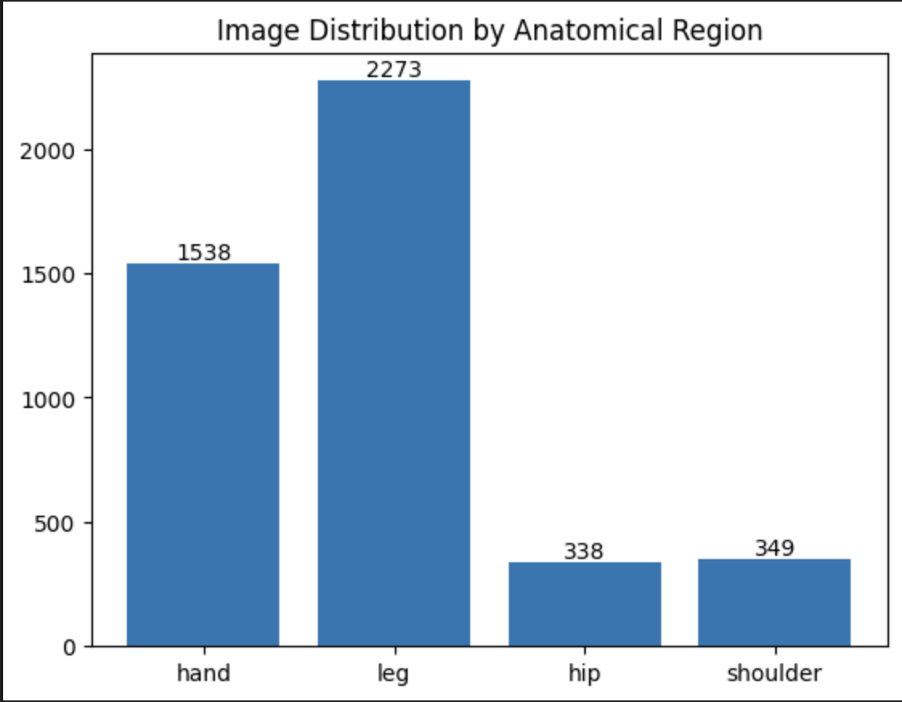
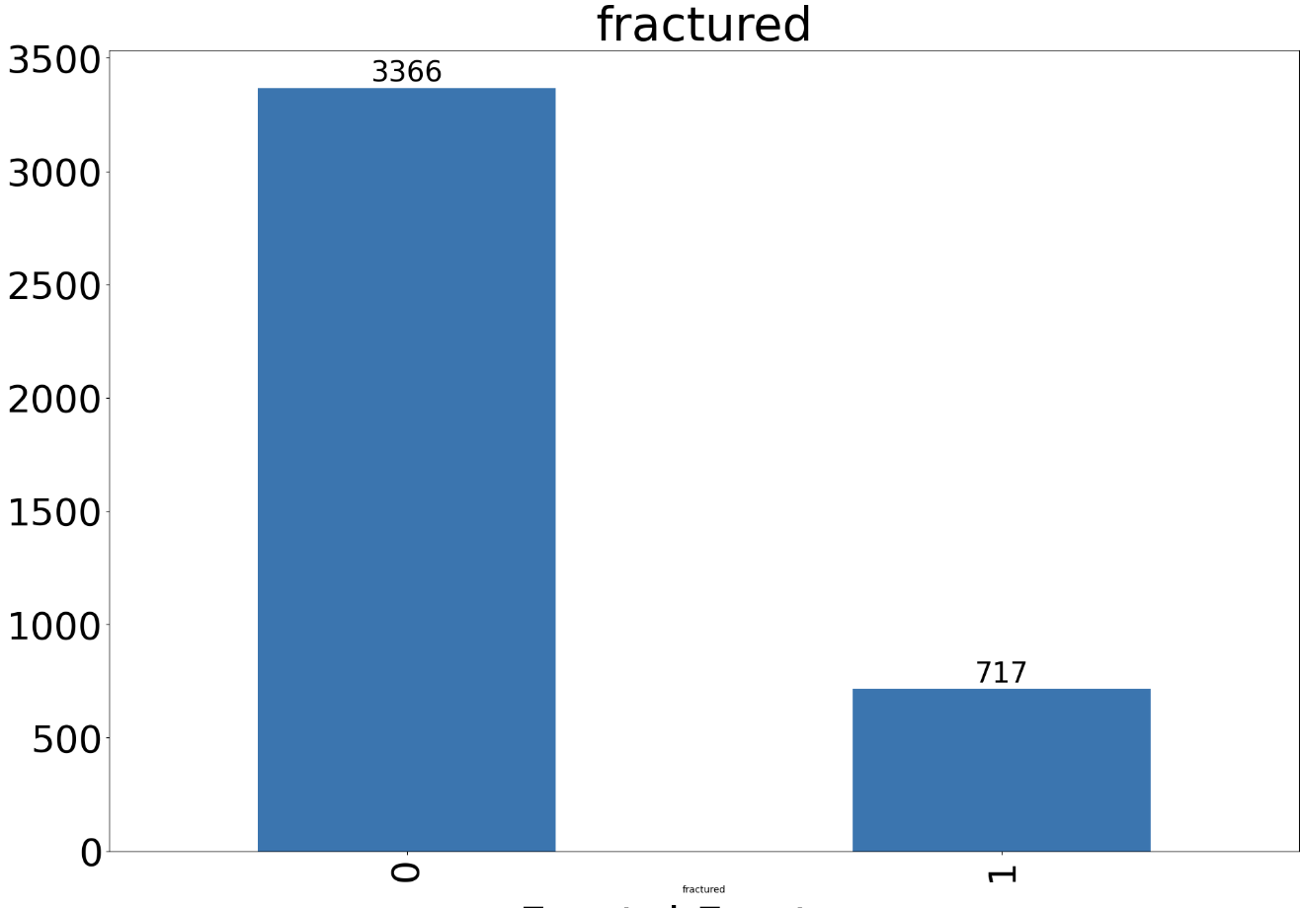
Summary of EDA insights
Inspect distribution of images
Fractured vs Non-Fractured
Leg, Hand, Shoulder, Hip locations
Visualize different fracture locations
Fractured images with provided annotations
Major Challenges:
Class imbalance
Small dataset

Slide 6
Modeling Pipeline
Data
Convert to 3-channel format
Apply CLAHE for contrast enhancement.
Resize images
Normalization
Augment the training data
Label preprocessing
Models
ResNet18
DenseNet
YOLOv8
Faster R-CNN
Evaluation
Localization: mAP, IOU
Classification: precision, recall, F1
Train with Oversampling
Evaluate and Refine
Notes:
Here is our overall approach laid out. We will each be using the same pre-processed data for training our individual models.
Moving in to training our models, we will each need to annotate the data images differently as the different models require different inputs.
And then once we are finished we will each evaluate the models using the same metrics so we have good baselines to compare against.

Slide 7
ResNet18 – Model Overview
Metric | Before Over | After Over | Understanding
Train Loss | 0.2966 | 0.2103 | Model fit training data more effectively
Val Loss | 0.8225 | 0.7551 | Generalization slightly improved
Dice | 0.0967 | 0.1196 | Better segmentation overlap
IoU | 0.0515 | 0.0650 | More accurate region prediction
mAP | 0.0600 | 0.0666 | Improved precision/recall tradeoff
F1 | 0.0966 | 0.1195 | Overall segmentation quality improved
Percision | 0.0519 | 0.0666 | Fewer false positives (improved localization)
Recall | 0.8343 | 0.7675 | Model still sensitive, but slightly more selective
Architecture
UNet
ResNet encoder
50 Epochs
Experiments
Before Oversampling
After Oversampling
Notes:
Because ResNet 18 is a classification model, what I set up for our segmentation project is a U-Net-style neural network designed for binary image segmentation, such as detecting fractures in medical images.
A U-Net is a type of convolutional neural network (CNN) architecture designed specifically for semantic segmentation tasks — where the goal is to assign a class label to each pixel in an image. It was originally developed for biomedical image segmentation, but it's now widely used in many segmentation applications
Using a pretrained ResNet-18 as the encoder to extract hierarchical features from the input image at multiple spatial resolutions. These features are progressively downsampled through layers nefore the decoder then upsamples the features using transposed convolutions, and then combining them with corresponding encoder outputs via skip connections to preserve spatial detail. Finally, a 1x1 convolution layer generates a single-channel output map representing raw segmentation logits, which can be converted to probabilities using a sigmoid function during evaluation.

Slide 8
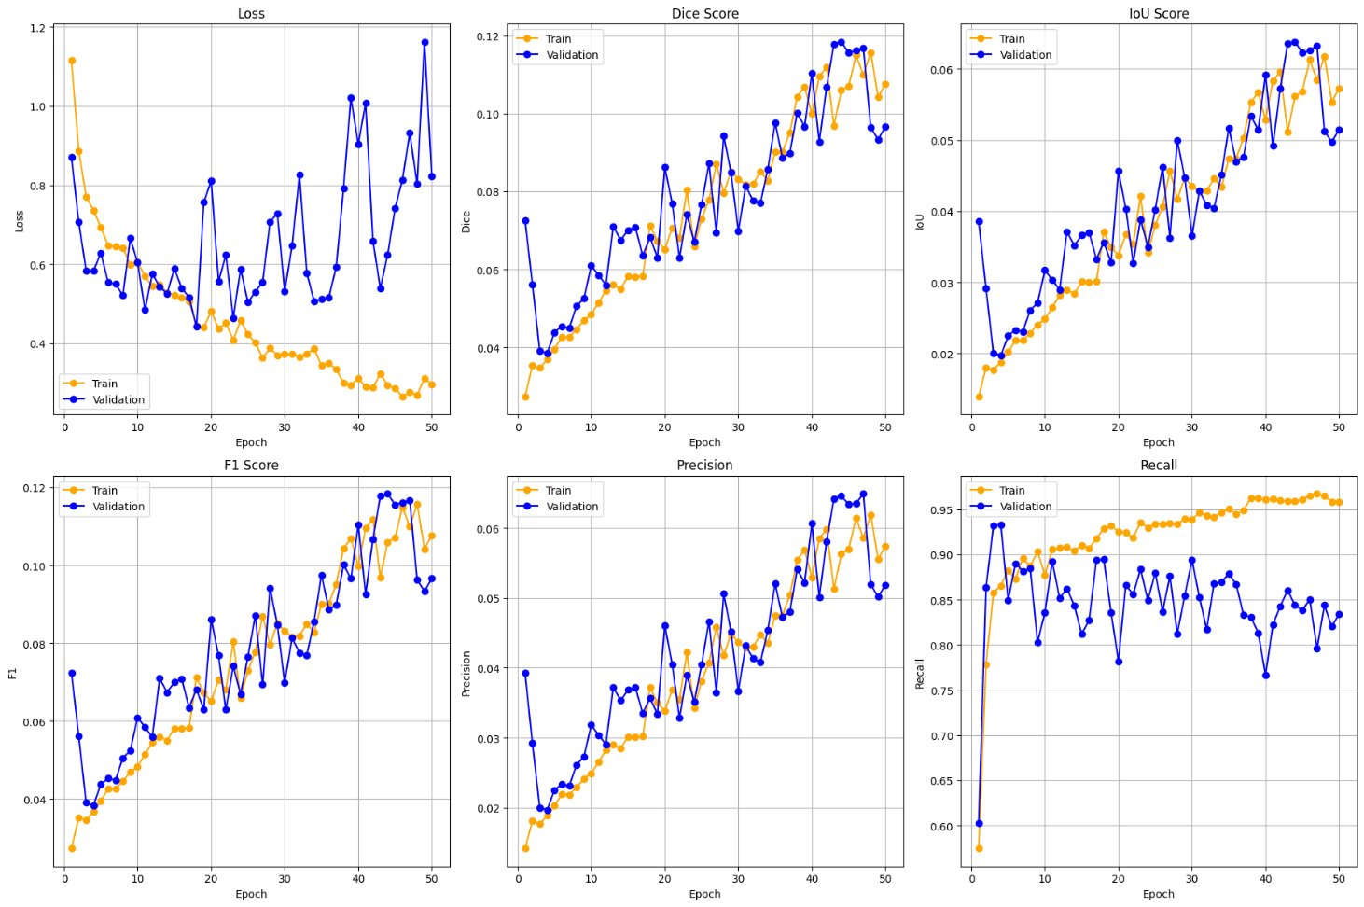
Before Oversampling

Slide 9
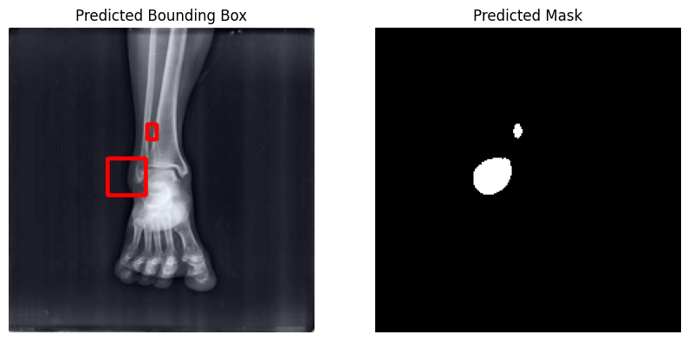
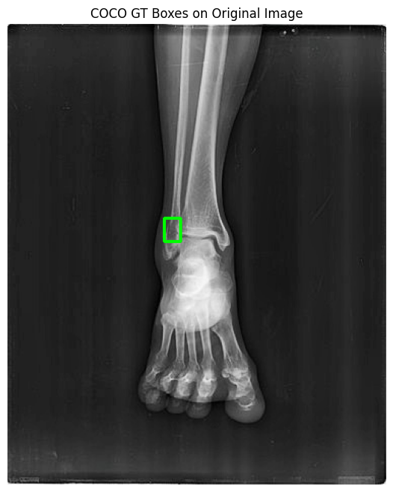
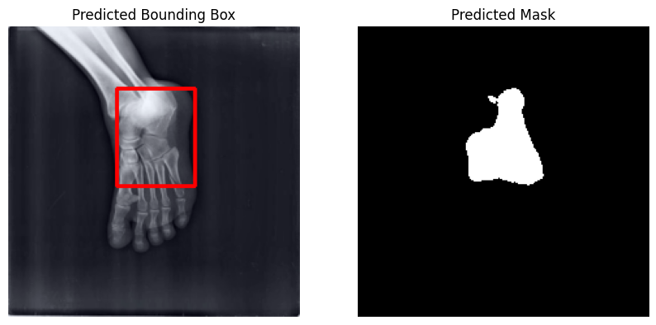
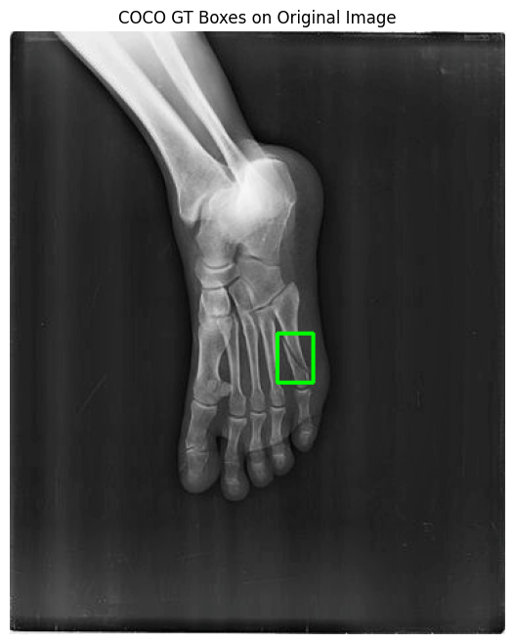

Slide 10
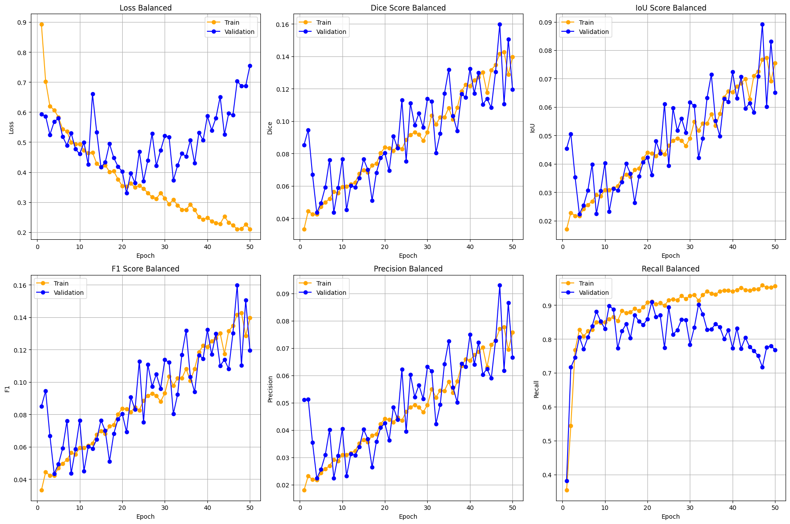
After Oversampling

Slide 11
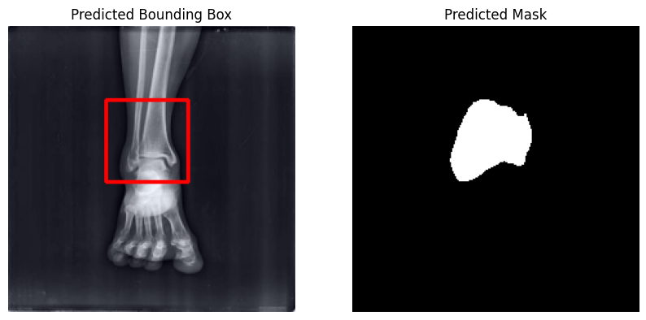
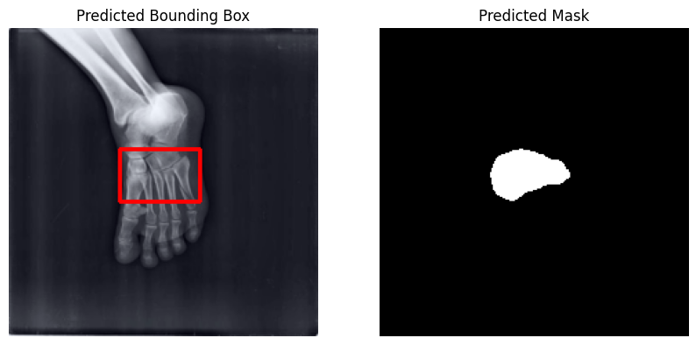
What worked, what didn’t

Slide 12
DenseNet121 – Model Overview
Architecture
UNet
ResNet encoder
50 Epochs
Experiments
No Oversampling
Oversampling
Oversampled & increased certainty threshold

Slide 13
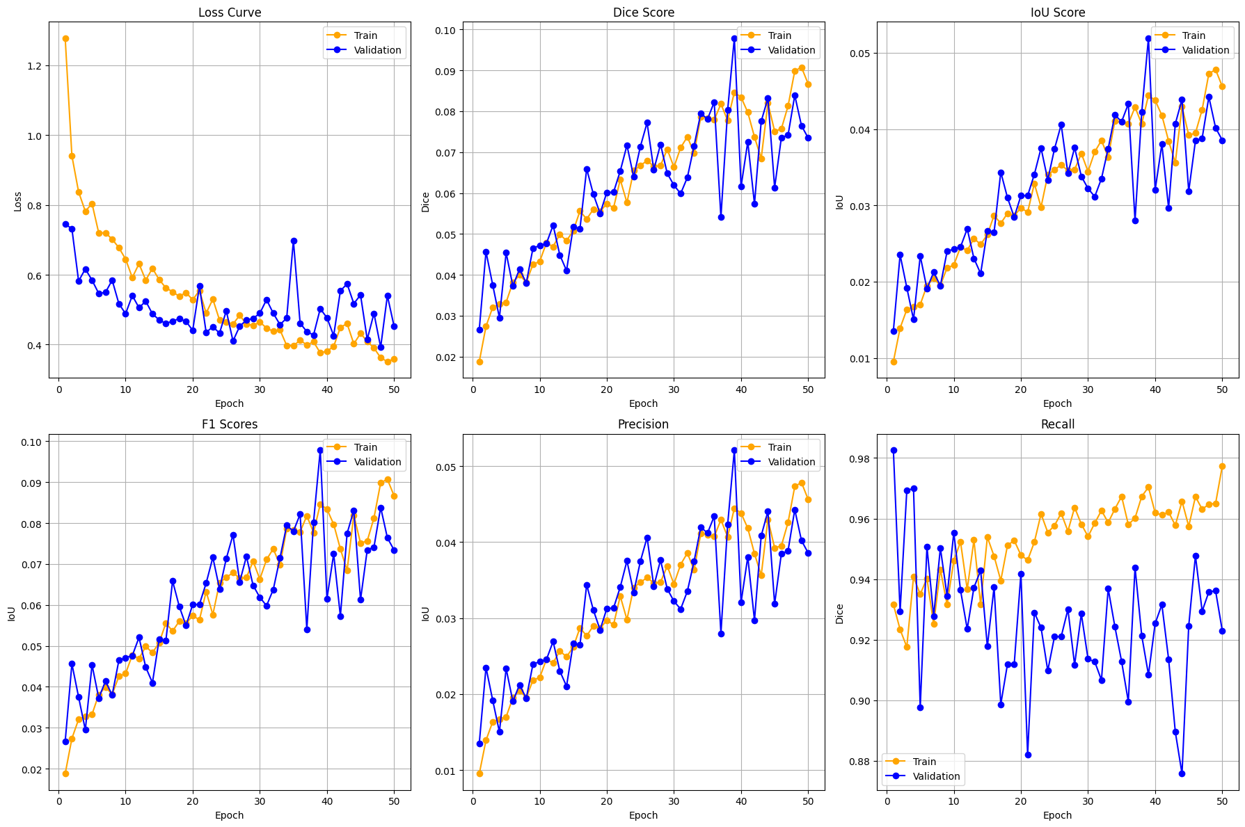
No Oversampling - DenseNet121

Slide 14
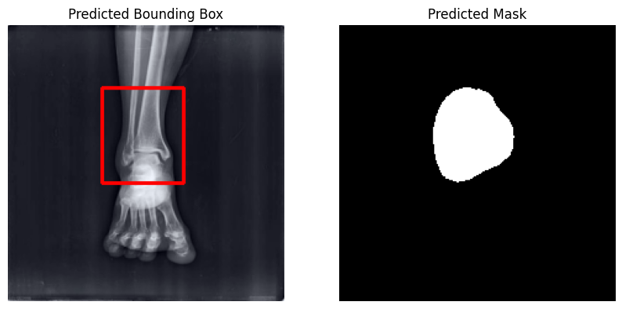
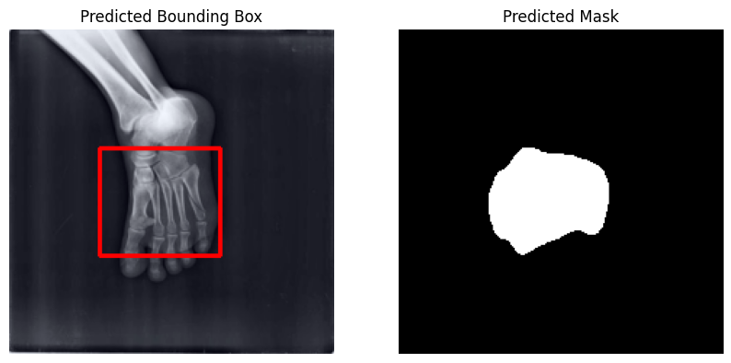

Slide 15
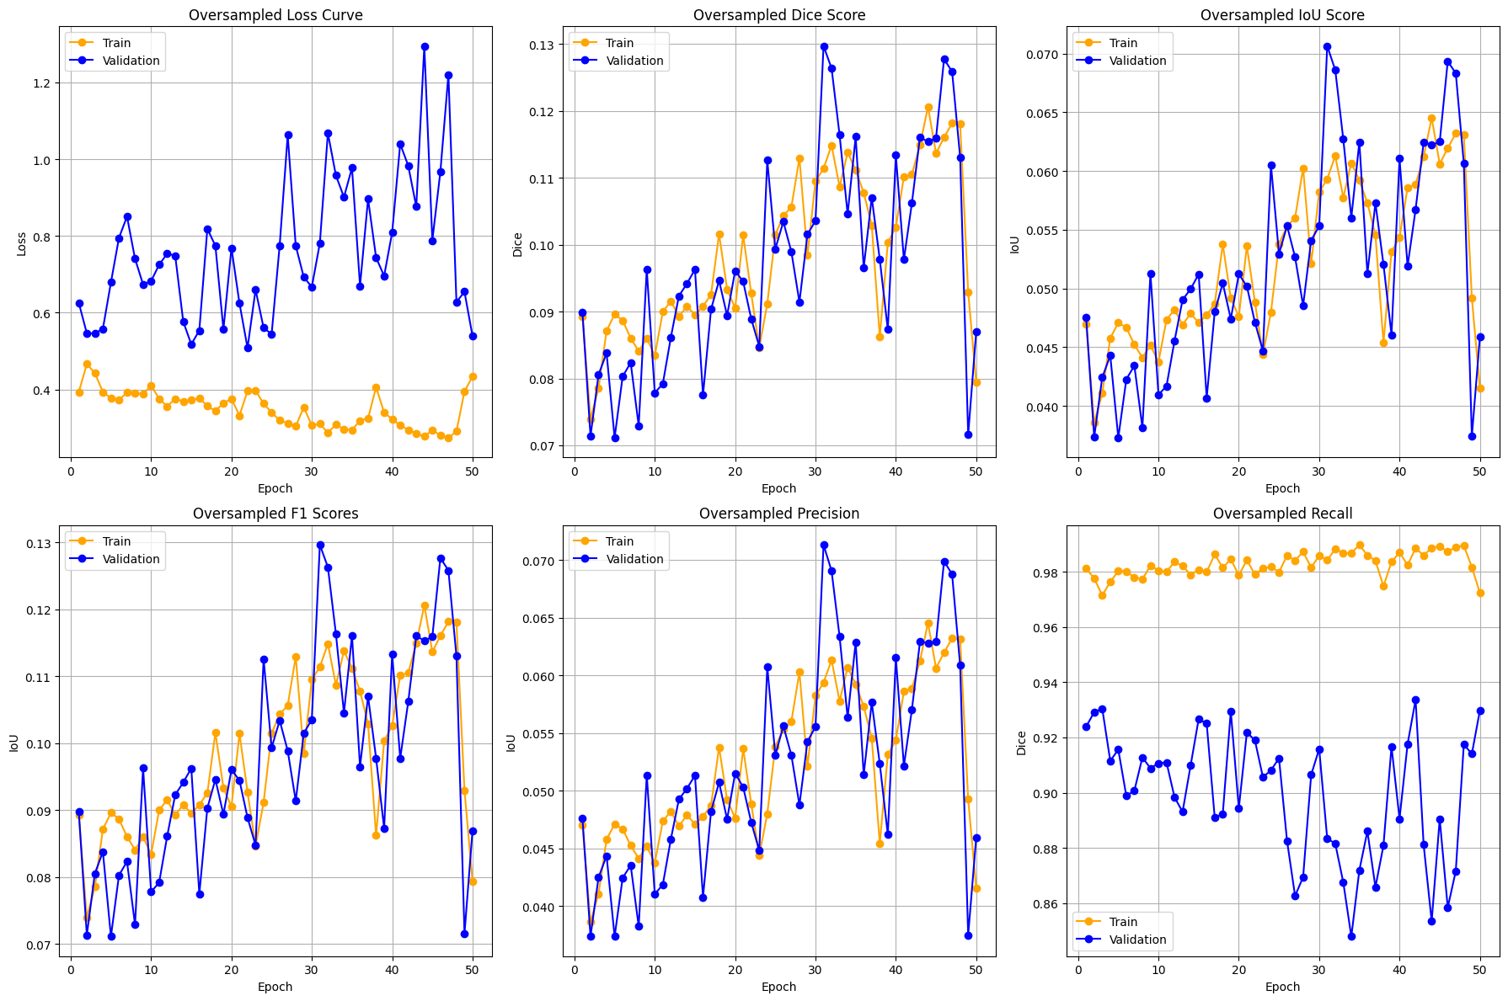
Oversampled

Slide 16
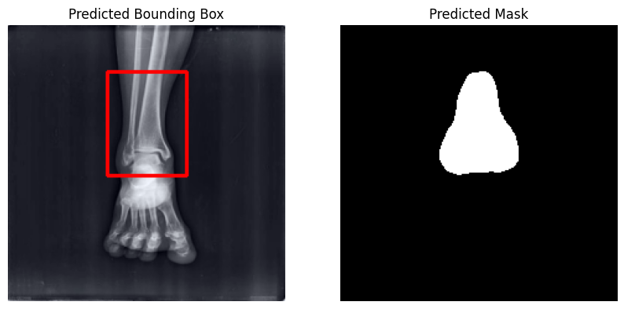
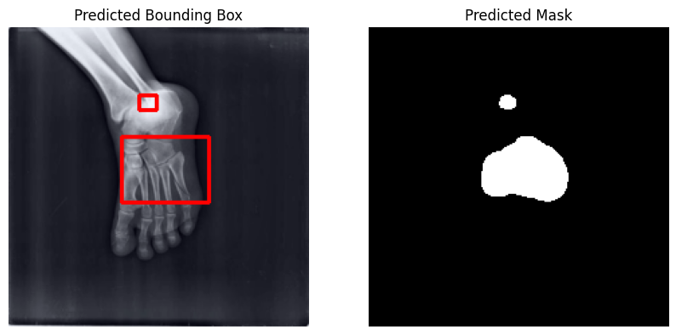

Slide 17
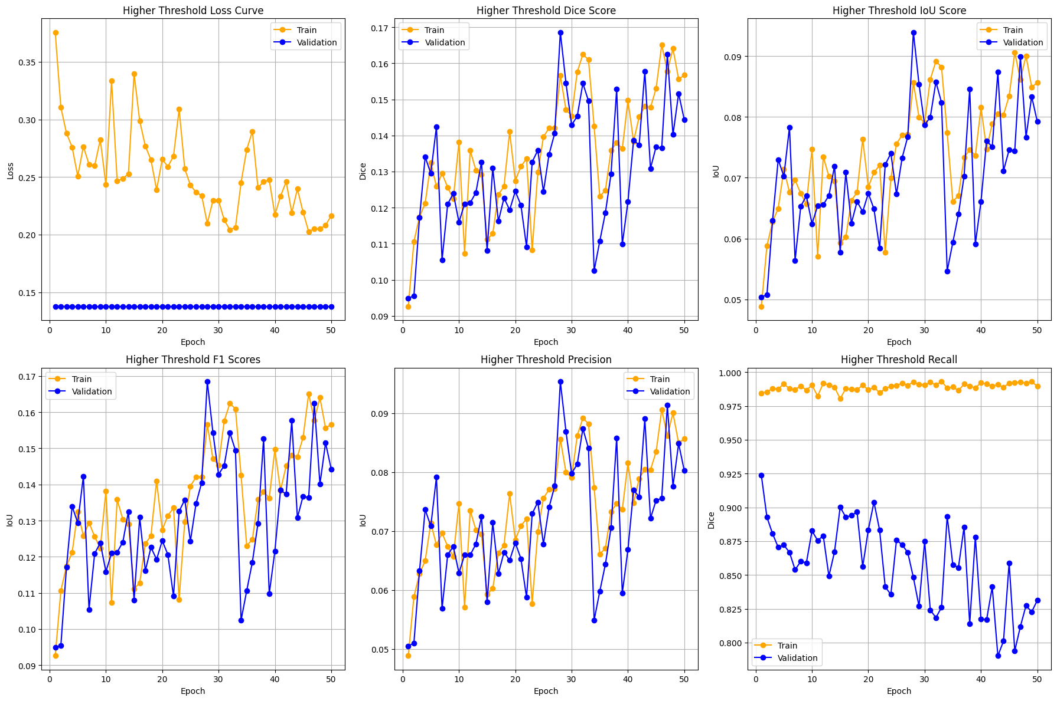
Oversampled & Increased Threshold

Slide 18
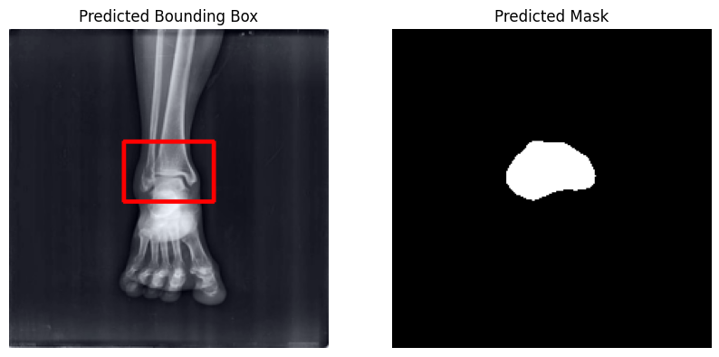
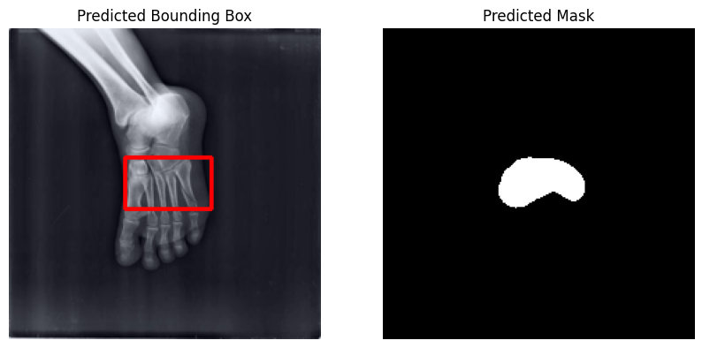

Slide 19
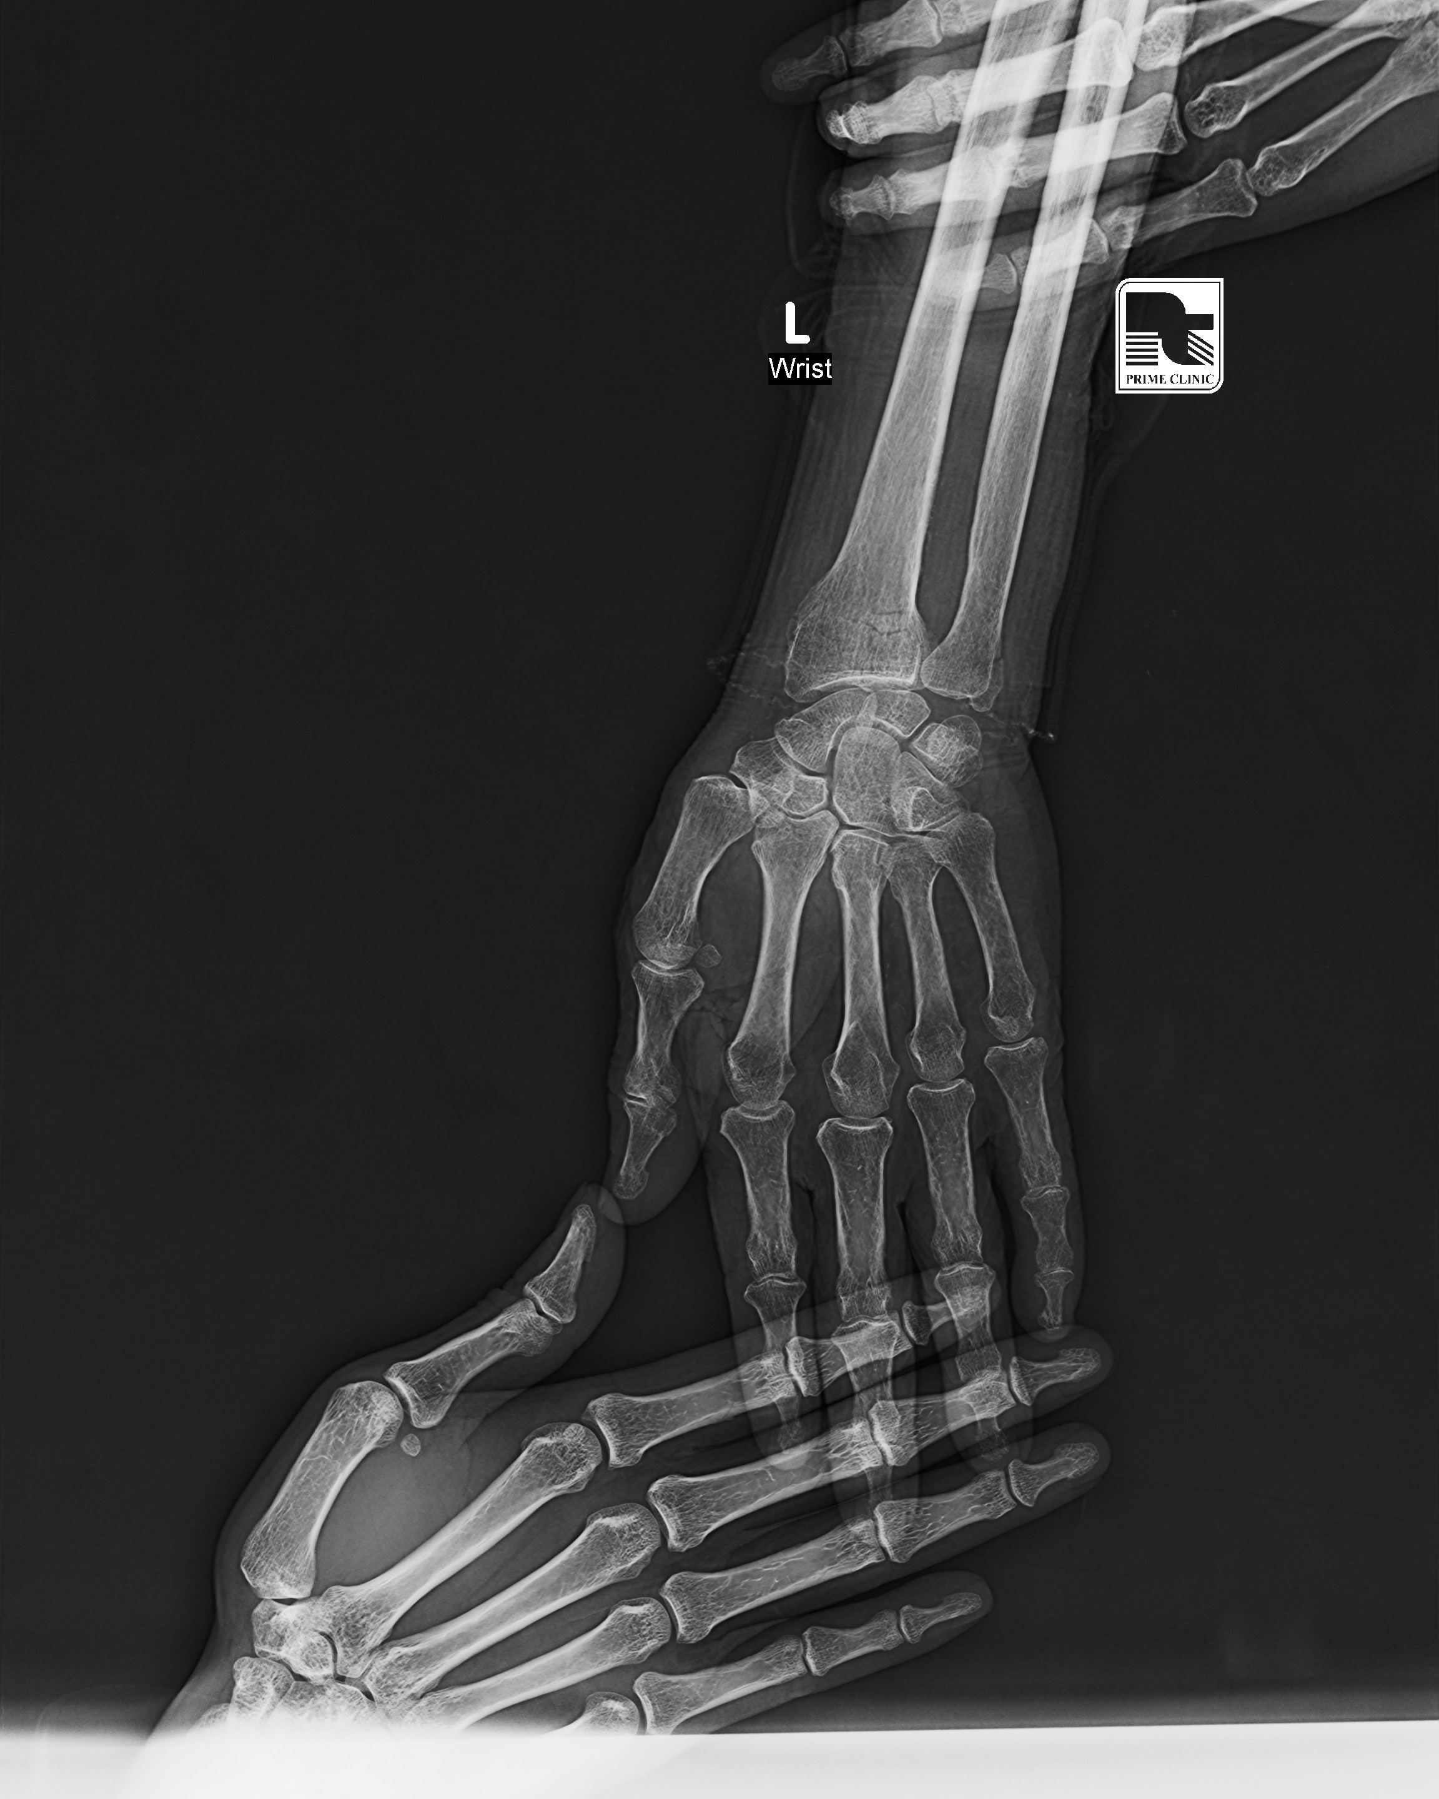
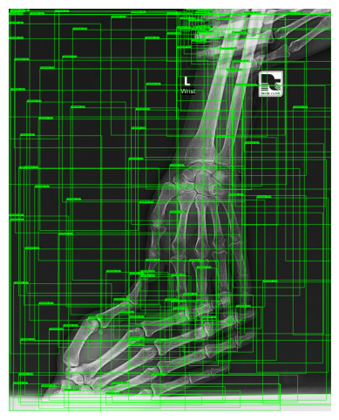
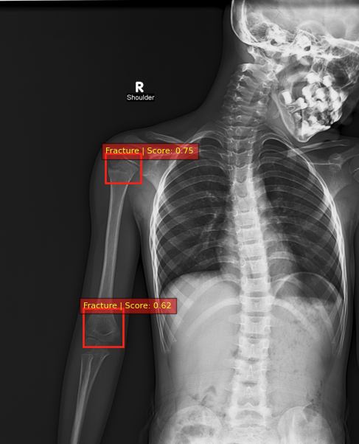
Faster R-CNN – Model Overview
Input Image (transformations)
RPN (Region Proposal Network)
RoI Pooling (Region of Interest)
Classification + Bounding Box Regression

Slide 20
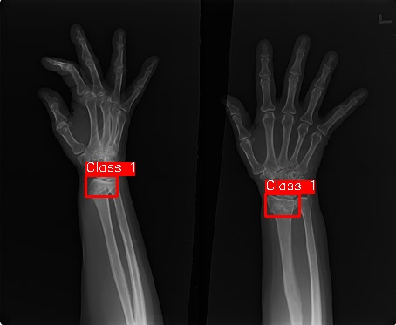
Faster R-CNN - Getting the model to work.
Out-of-the-box annotations
Faster R-CNN "Targets"
{
"id": 19,
"iscrowd": 0,
"image_id": 20,
"category_id": 0,
"segmentation": [[
1435.6614626129829, 775.4642563681184, 1367.0829909613806,
770.1889893179952, 1312.5718981101068, 793.0484798685292,
1314.330320460148, 858.1101068200494, 1379.391947411668,
851.076417419885, 1451.4872637633525, 847.5595727198029,
1458.5209531635169, 791.2900575184881
]],
"bbox": [
1312.5718981101068, 770.1889893179952, 145.94905505341012,
87.92111750205424
],
"area": 10534.611491949487
},
{
"id": 20,
"iscrowd": 0,
"image_id": 20,
"category_id": 0,
"segmentation": [[
570.5176663927691, 750.8463434675432, 494.9055053410025,
761.3968775677897, 470.28759244042726, 829.975349219392,
505.45603944124895, 842.2843056696796, 575.7929334428924,
822.9416598192277, 596.8940016433854, 778.9811010682005
]],
"bbox": [
470.28759244042726, 750.8463434675432, 126.60640920295816,
91.43796220213642
],
"area": 7934.198147444215
},
}
IMG00000019.jpg targets: {'boxes': tensor([[1312.5719, 770.1890, 1458.5210, 858.1101], [ 470.2876, 750.8463, 596.8940, 842.2843]]), 'labels': tensor([1, 1]) }

Slide 21
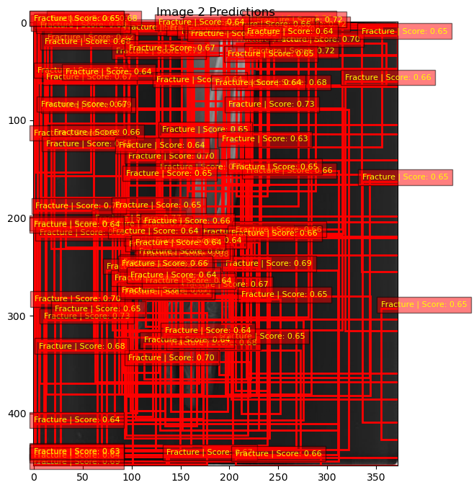
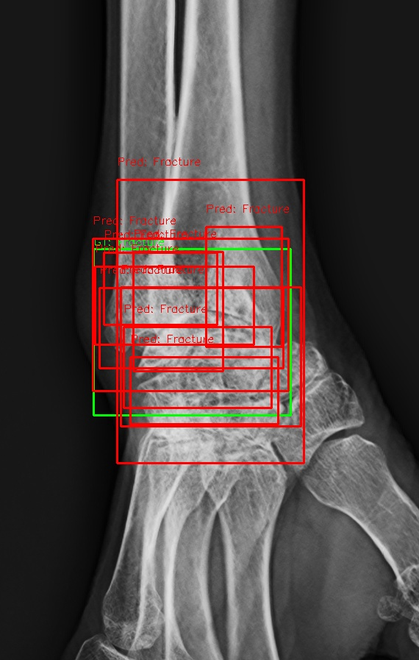
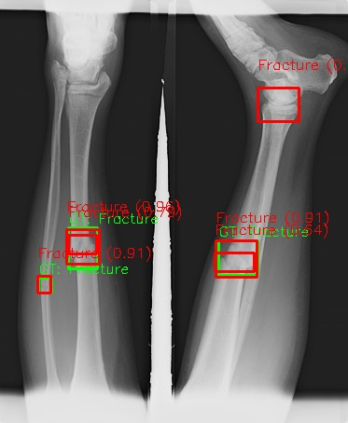
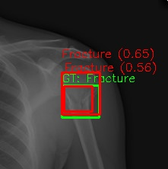
Faster R-CNN - Training
Epoch 2 Underfitted
Epoch 0

Slide 22
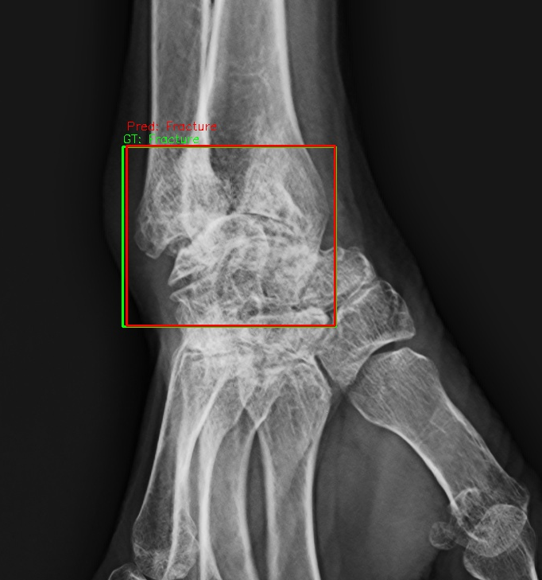
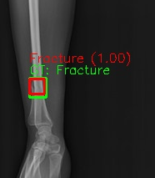
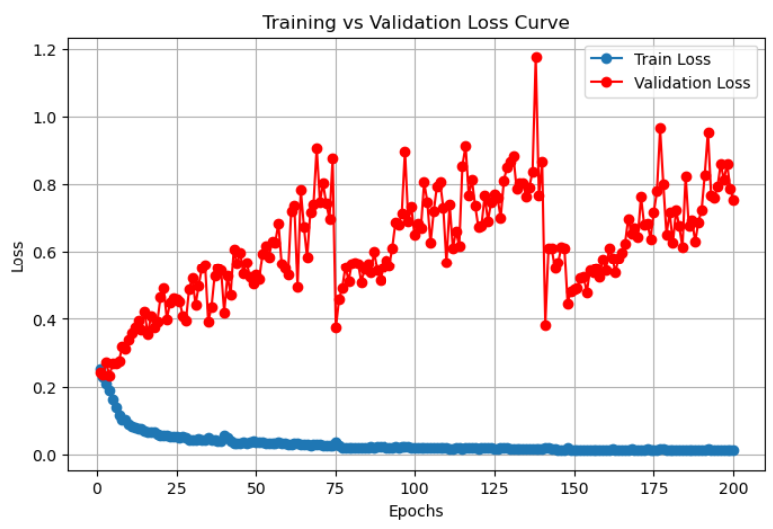
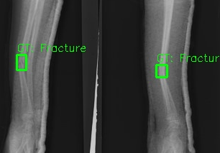
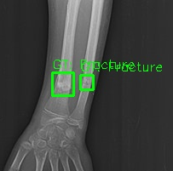
Faster R-CNN - Training
Epoch 200 - Overfitted

Slide 23
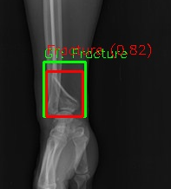
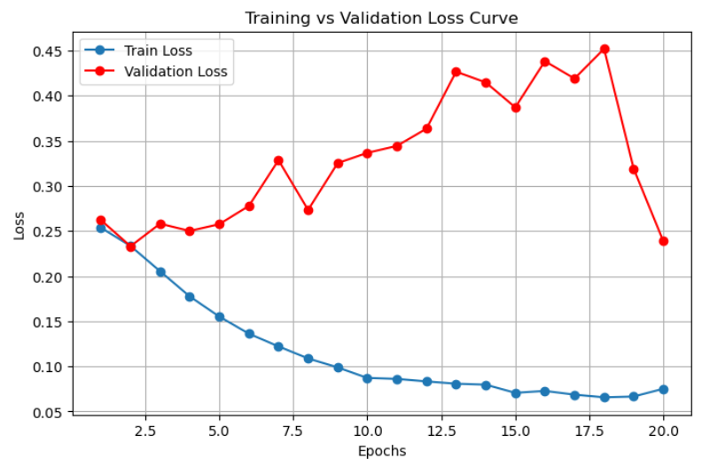
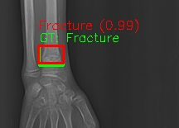
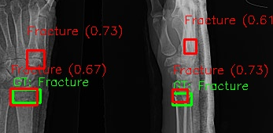
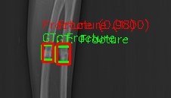
Faster R-CNN - Performance
Epoch 20 – Sweet spot

Slide 24
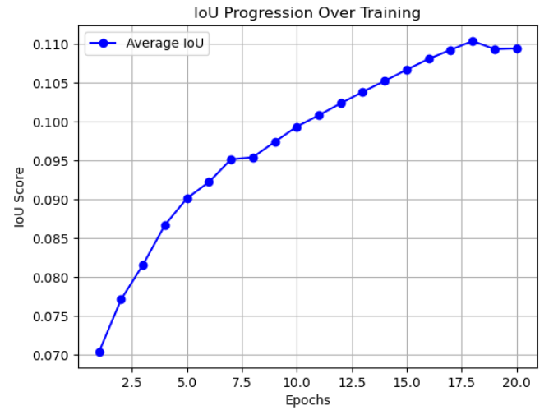
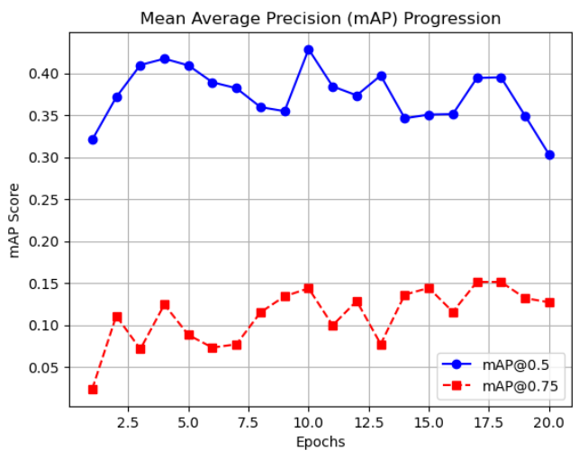
Faster R-CNN (end)

Slide 25
YOLOv8 – Model Overview
Developer: Ultralytics (released in 2023)
Task: Real-time object detection, classification, segmentation, and pose estimation
Architecture:
Anchor-free detection head (simpler and more efficient)
CSPDarknet-based backbone with improvements for speed and accuracy
Key Features:
Supports multiple tasks (detection, segmentation, classification, pose)
High performance with low latency — suitable for real-time use

Slide 26
YOLOv8 – Data Preparation
Applied Contrast Limited Adaptive Histogram Equalization (CLAHE) to enhance local contrast.
Oversampled fracture images (4x duplication).
Structured in YOLOv8 format.

Slide 27
YOLOv8 – Training Setup
Ultralytics library
Model: YOLOv8m.pt
Image size: 640x640
Built-in loss functions and default YOLO augmentations used.

Slide 28
YOLOv8 - Experiments
Model | Optimizer | Learning rate | Epochs
Experiment 0 | SGD | 1e-3 | 50
Experiment 1 | SGD | 1e-4 | 50
Experiment 2 | Adam | 1e-3 | 50
Experiment 3 | Adam | 1e-3 | 100
Experiment 4 | Adam | 1e-4 | 100
Models | mAP@0.5 | mAP@[0.5:0.95] | precision | recall | f1
Experiment 0 | 0.596 | 0.325 | 0.844 | 0.403 | 0.545
Experiment 1 | 0.434 | 0.251 | 0.73 | 0.164 | 0.268
Experiment 2 | 0.473 | 0.245 | 0.75 | 0.179 | 0.289
Experiment 3 | 0.504 | 0.223 | 0.75 | 0.269 | 0.396
Experiment 4 | 0.513 | 0.287 | 0.724 | 0.313 | 0.438

Slide 29
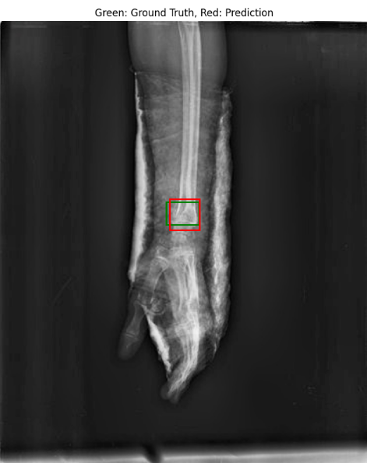
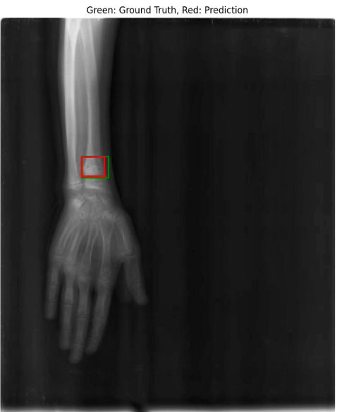

Slide 30
Compare Results
Models | MAP@0.5 | Precision | Recall | F1
ResNet18 | 0.0666 | 0.0666 | 0.767 | 0.1195
DenseNet121 | 0.1628 | 0.0513 | 0.7313 | 0.0942
Faster R-CNN | 0.303 | 0.6083 | 0.4875 | 0.517
YOLOv8 | 0.596 | 0.844 | 0.403 | 0.545

Slide 31
Result Discussion
Best model: YOLOv8 – Demonstrated the highest localization accuracy with a strong balance of precision and efficiency
Worst model: ResNet18 – Struggled with fracture detection, showing low mAP and poor localization performance.
What techniques work:
Streamlined pipeline and feedback loop
Gathering training data to refine training
What doesn't:
Oversampling yielded negligible results for this dataset.
Key takeaways:
Model Architecture matters.

Slide 32
Reflections
What we did well:
Collaboration
We were able to rely on each other to do their part
What we did not achieve:
Did not implement Grad-Cam as planned
Modeling pipeline is somewhat inconsistent across models

Slide 33
Contributions
Aria Kieras
EDA
Data pre-processing
ResNet18 Specialist (baseline)
Jeff Conner: DenseNet121 Specialist (baseline)
David Boulos: Faster R-CNN Specialist (Initial solution)
Nhu Tran: YOLOv8 Specialist (Refined Solution)

